Slide 1

Improving Python Speed with a Bit of Rust​
Michigan Python
fosstodon.org/@danyeaw

Slide 2
The Importance of Speed
It can be easy to focus on execution speed
Development speed is also important
Absolute speed isn’t usually very important, but acceptable speed is
Always benchmark, your intuition for what is slow is usually wrong
Sometimes even optimized Python isn’t fast enough

Slide 3
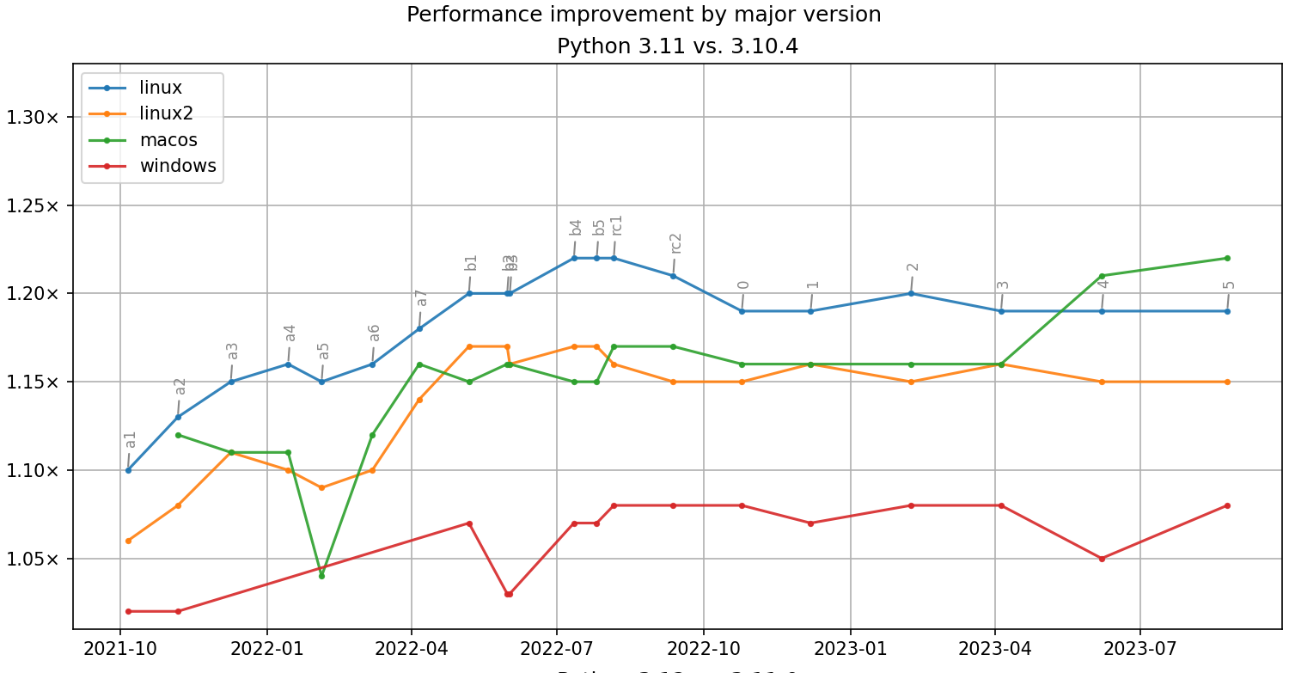
Python is Getting Faster
Python 3.13 has plans for:
Tier 2 Optimizer
Enabling subinterpreters
Improved Memory Management
The Shannon Plan – 5x Increase in Python Speed

Slide 4
Weakest Performance of Python - a Hot Loop
Multiply two huge matrices (numpy can help here)
String search for very large strings
Index or compress huge files
Calculate large numeric values
Rotate a 2D matrix, or an image (OpenCV can help here)
Cryptographic calculations

Slide 5

Rust Leadership Issues
Rust leadership invited JeanHeyd "ThePhD" Meneide (editor of the C standard) to work on Rust reflection
They also invited him to give a keynote about it at RustConf, and then later revoked the invitation
Instead of providing a sincere apologies and making changes so this would never happen again, they released basic statements and are still arguing about details
The leadership system that allowed for this is racist, and it gives me pause about using or talking about Rust

Slide 6
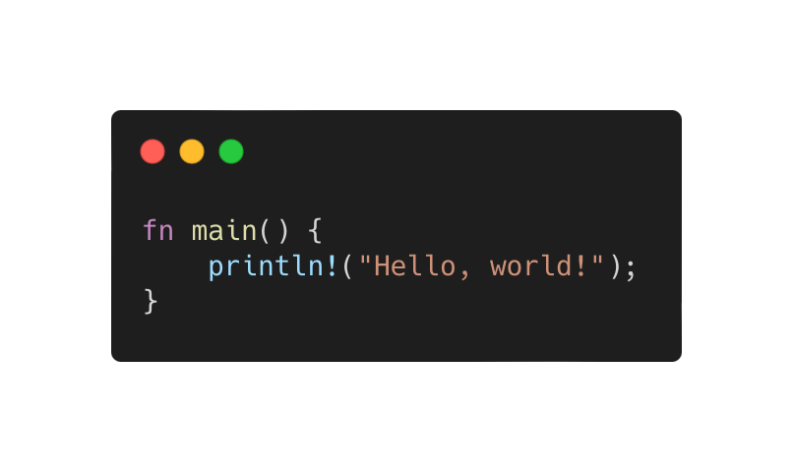
Rust – Focuses on Safety and Performance

Slide 7
Rust Focuses on Concurrency
CPython
Dynamic and strongly typed
Interpreted
Limited Concurrency with Global Interpreter Lock
Reference counting memory
Rust
Statically Typed
Compiled to machine code
Concurrent programming with threads and message passing
Ownership and tracking of memory at compile time

Slide 8


Other Options – JIT Compilers
PyPy - a Python implementation with a JIT compiler
Pros: runtime optimizations with normally no changes needed to your code
Cons: non-CPython runtime, relatively large resource usage of the runtime, not as performant as other options
Numba - a Python extension that features a JIT compiler, targets numerical code like NumPy.
Pros: runtime optimizations, easy to use with a decorator to your functions
Cons: limited language support, relatively large runtime dependency (LLVM)

Slide 9


Other Options – Python-to-C Extension Compilers
mypyc - Based on the mypy static Python analyser, makes use of type annotations to optimize code for static types
Pros: good support for Python and typing, good type inference, reasonable performance gains
Cons: no support for low-level optimizations and typing, opinionated Python type interpretation, reduced Python compatibility and introspection after compilation
Nuitka – Compiles an executable or a C extension
Pros: highly language compliant, reasonable performance gains, support for static application linking
Cons: no support for low-level optimizations and typing

Slide 10

Other Options Python with C data types
Cython
Pros: supports all Python versions, C level performance is possible
Cons: Need to learn a new Cython superset language (cdef)

Slide 11
Installing Rust
Rustup at https://rustup.rs is the preferred way to install Rust
Windows: Download the rustup-init.exe
Linux/macOS:
$ curl --proto '=https' --tlsv1.2 -sSf https://sh.rustup.rs | sh
Alternatively you may be able to install rustc and cargo using your package manager (Chocolately, Homebrew, apt, etc)

Slide 12

PyO3 and Maturin
PyO3 is Rust bindings for Python
Maturin (formerly pyo3-pack) is a library to build and publish crates with pyo3 and rust binaries as python packages
These will allow us to setup Rust modules alongside our Python, and then import it to use in our Python program

Slide 13
Example: Search a Huge String for Doubles
Create a random string of ascii characters that is 1,000,000 characters
Count the number of times two of the same characters are next to each other
tqQzXXcHjVsjTQyPVQtyzZodasWkpmyGCvBAYogMliuoppJbrGyjhTcMoaf
c2
c1

Slide 14
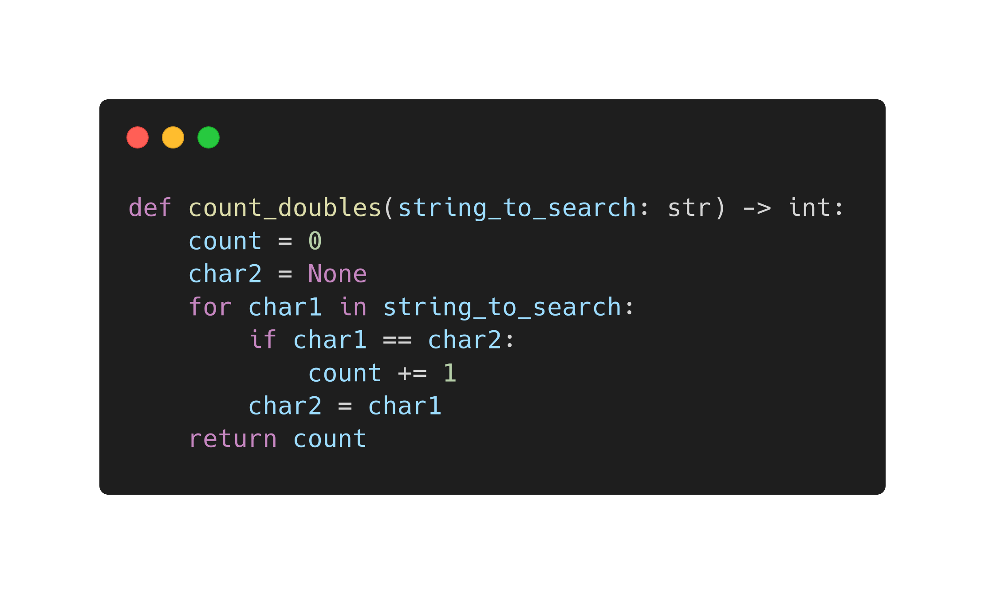
Count Doubles in Python

Slide 15
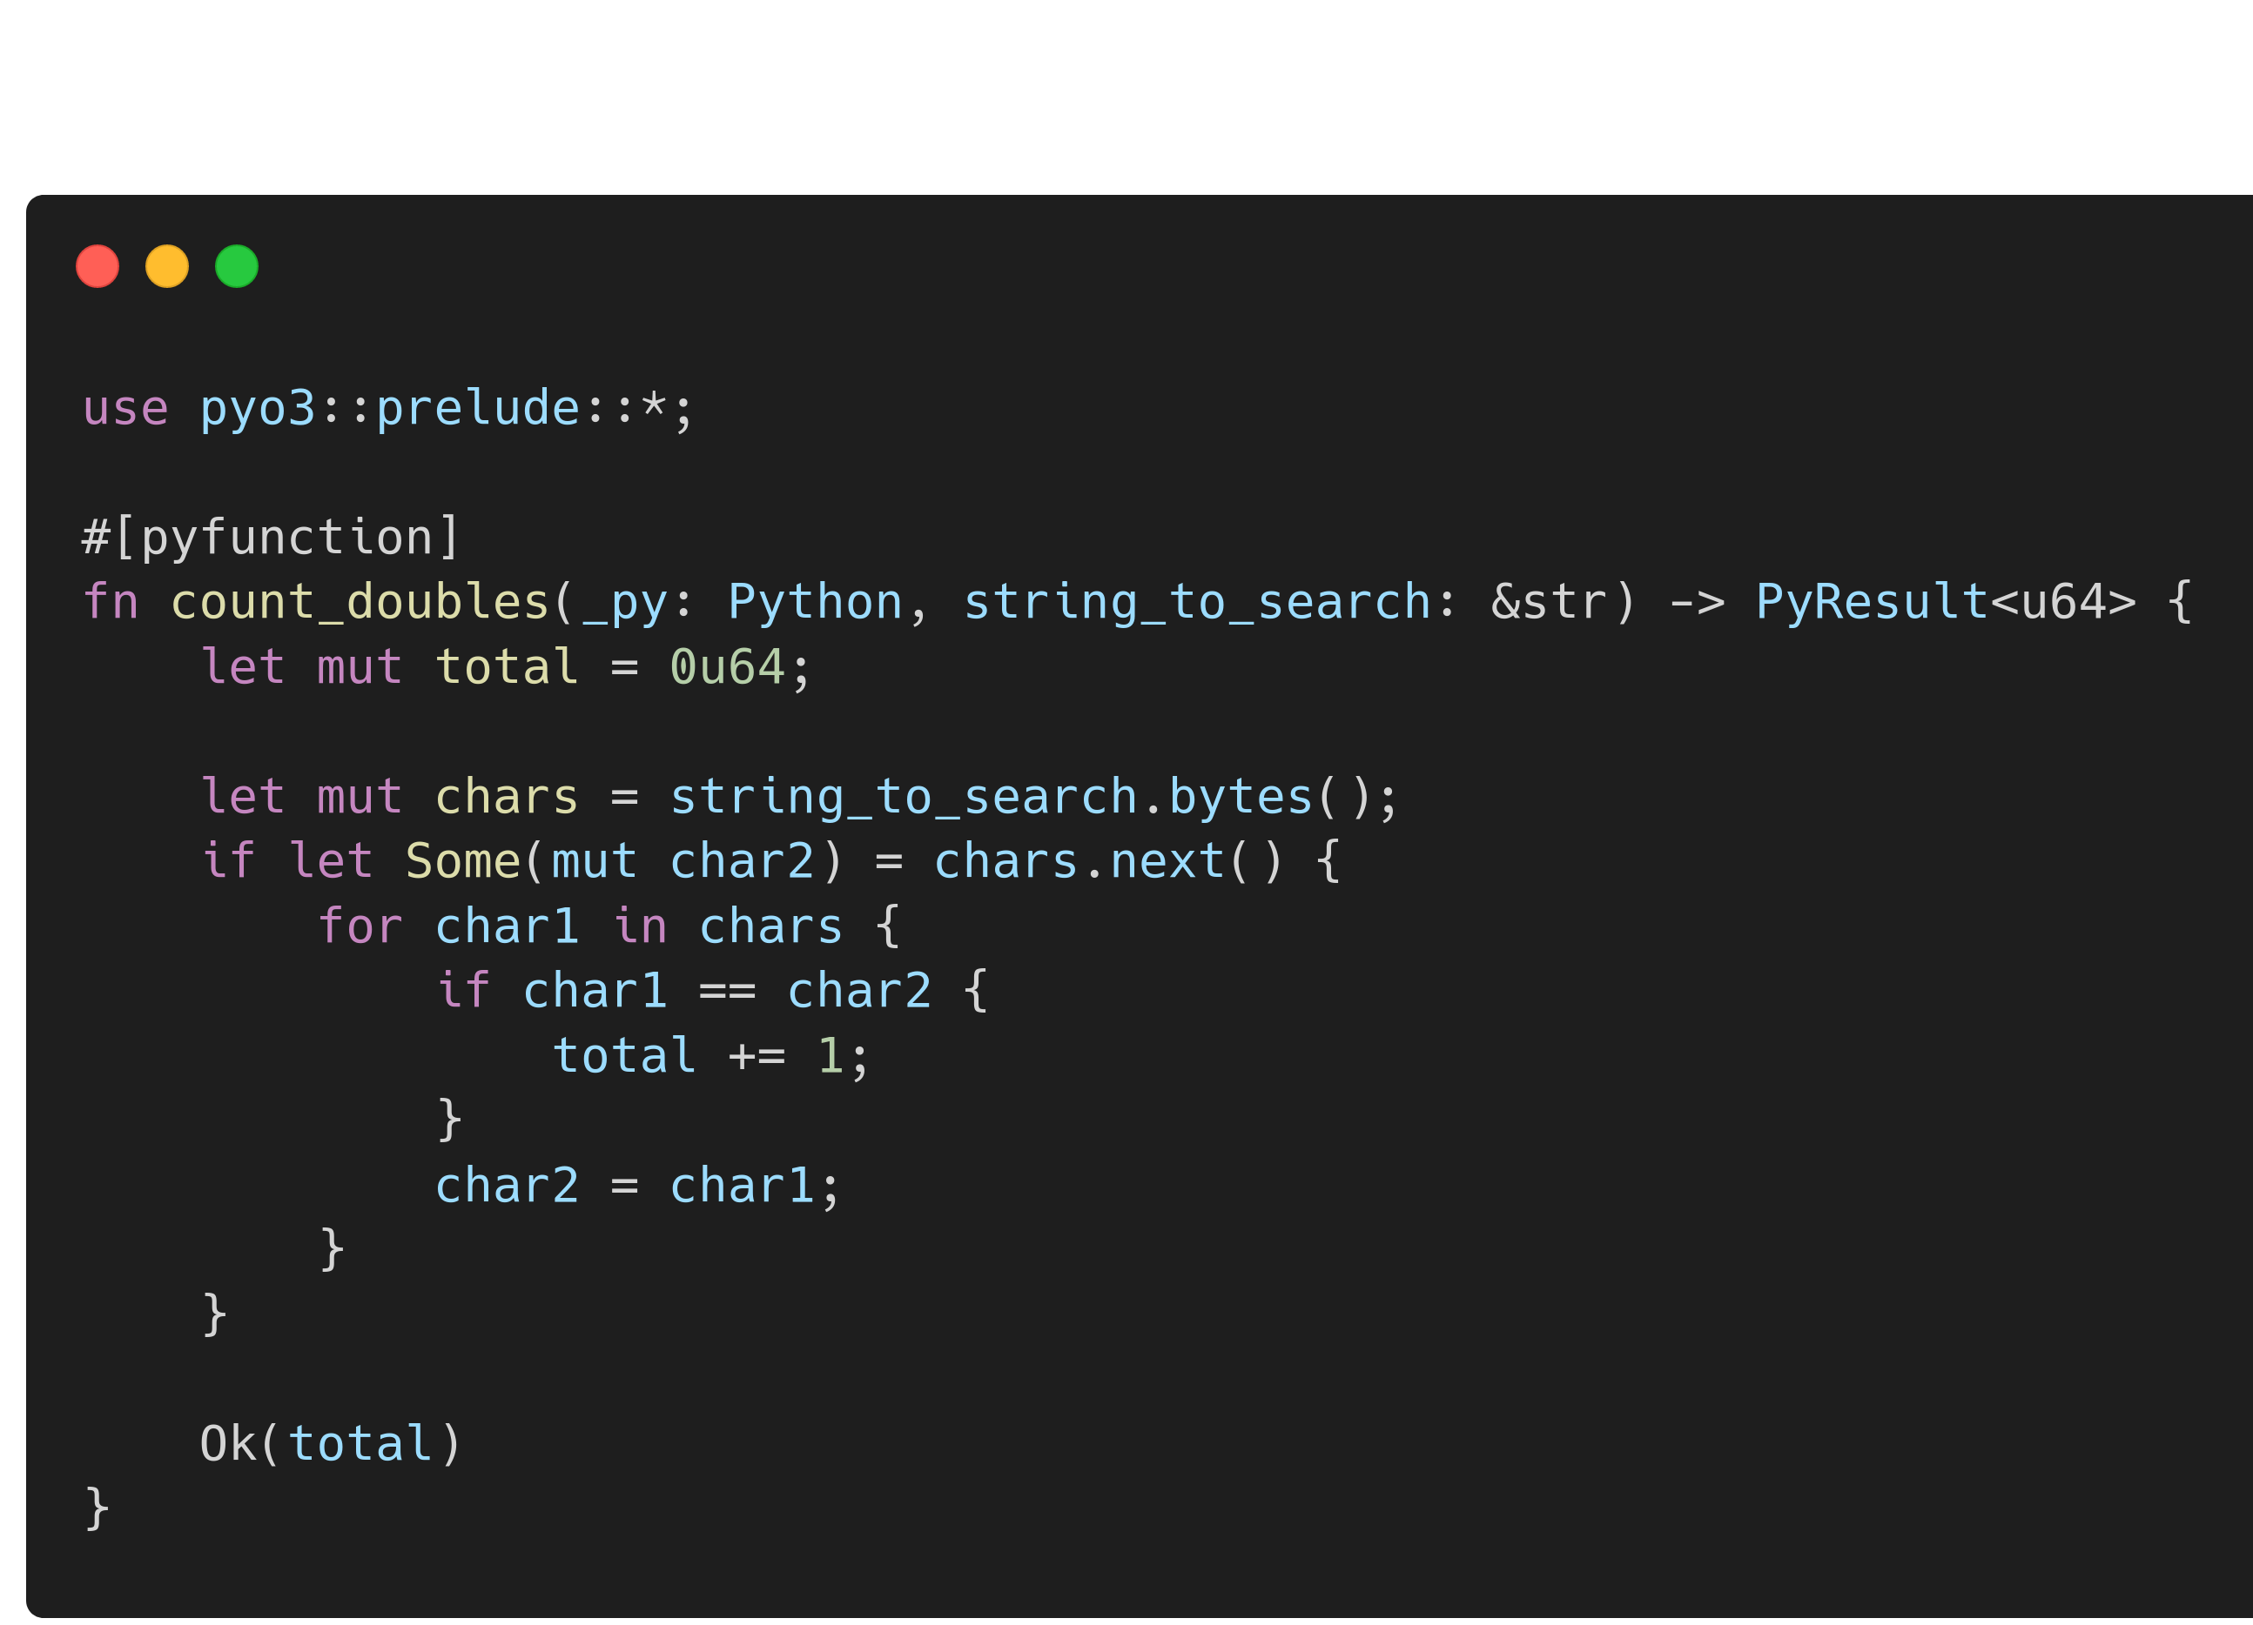
Count Doubles in Rust

Slide 16
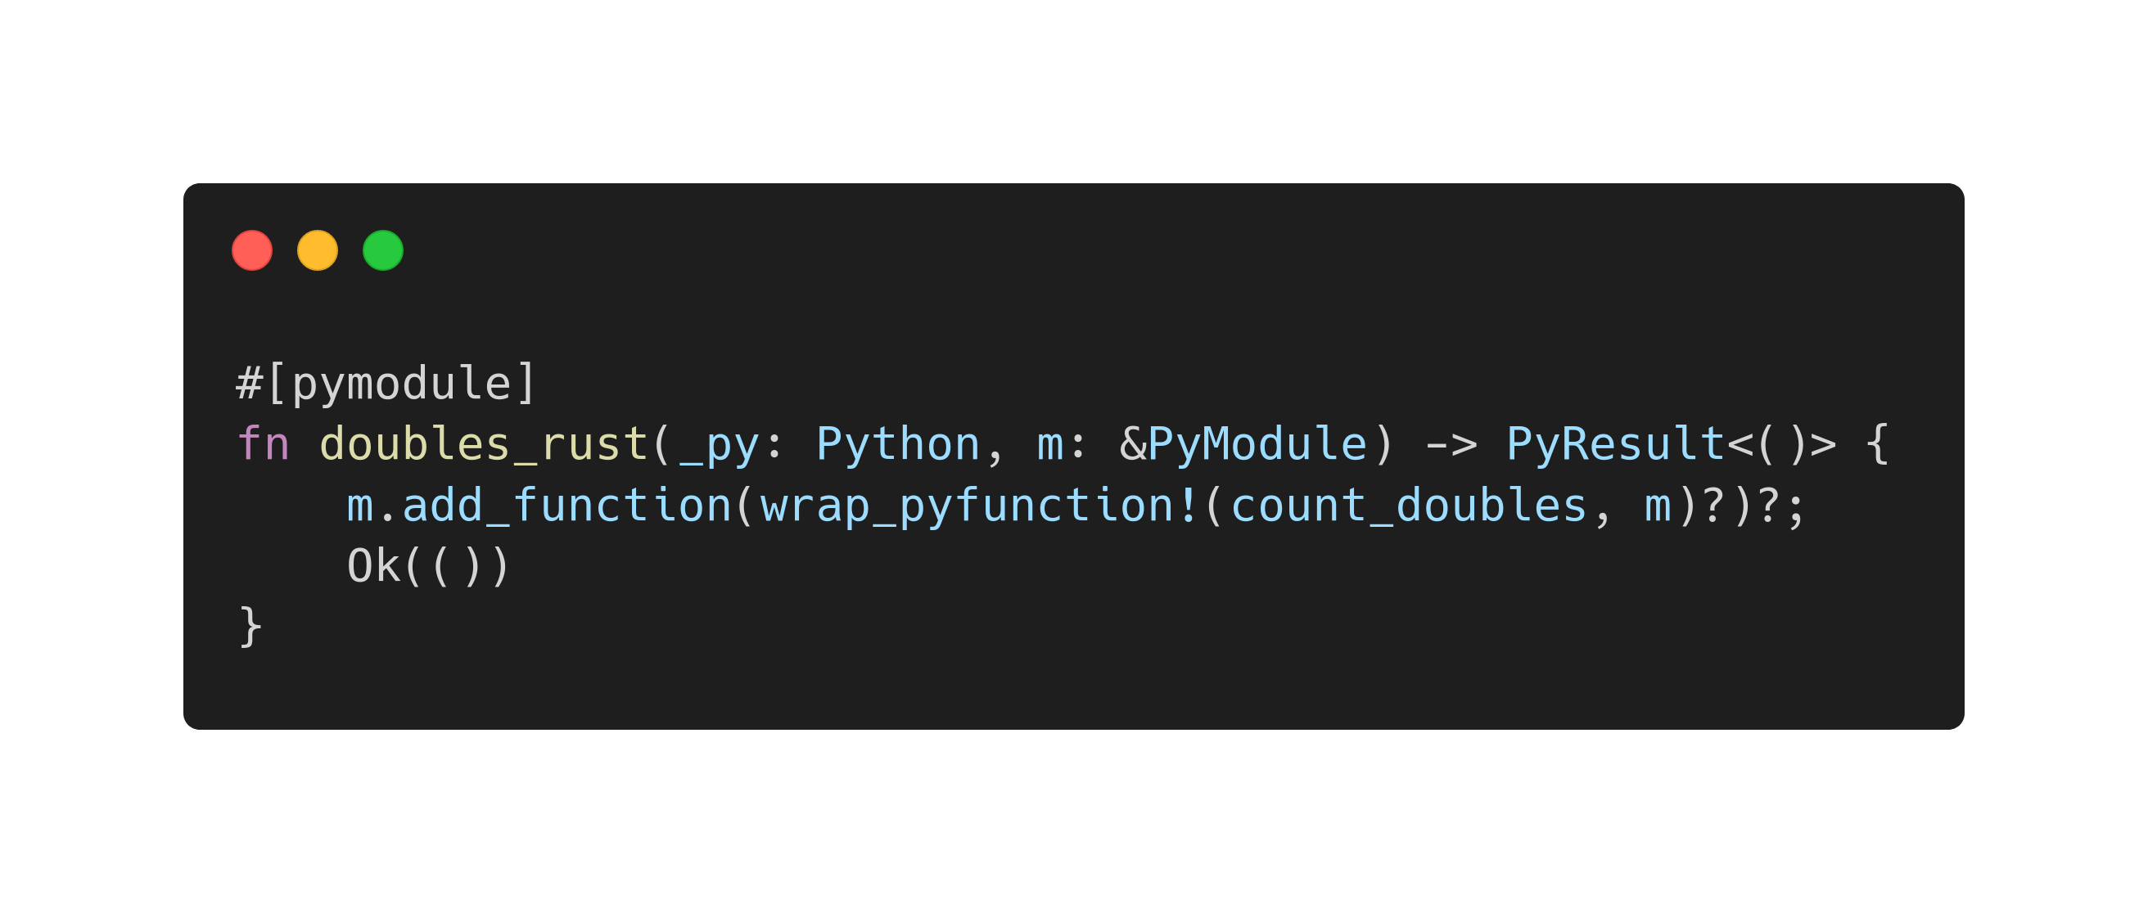
Create a Python Module with Rust

Slide 17
Let's See it Live!
Credit to Bruno Rocha for the Doubles counting idea:
https://developers.redhat.com/blog/2017/11/16/speed-python-using-rust

